Slide 1
Contents
In today’s lecture we’ll have a look at:
  Bresenham’s line drawing algorithm

Slide 2
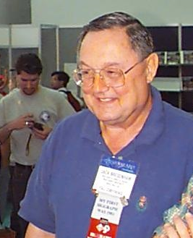
The Bresenham Line Algorithm
The Bresenham algorithm is another incremental scan conversion algorithm
The big advantage of this algorithm is that it uses only integer calculations
Jack Bresenham worked for 27 years at IBM before entering academia. Bresenham developed his famous algorithms at IBM in the early 1960s

Slide 3
The Big Idea
Move across the x axis in unit intervals and at each step choose between two different y coordinates
For example, from position (2, 3) we have to choose between (3, 3) and (3, 4)
We would like the point that is closer to the original line
5
(x_{k}+1, y_{k}+1)
4
(x_{k}, y_{k})
3
(x_{k}+1, y_{k})
2
2
3
4
5

Slide 4
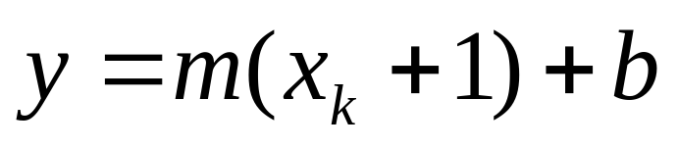
Deriving The Bresenham Line Algorithm
At sample position x_{k}+1 the vertical separations from the mathematical line are labelled d_{upper} and d_{lower}
y_{k+1}
d_{upper}
y
d_{lower}
y_{k}
x_{k}+1
The y coordinate on the mathematical line at x_{k}+1 is:

Slide 5
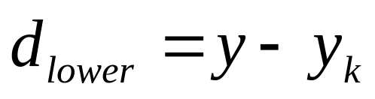
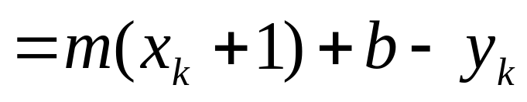
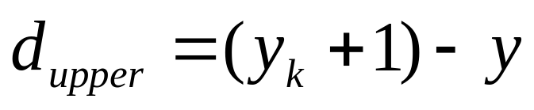
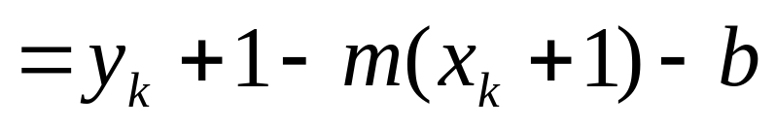
Deriving The Bresenham Line Algorithm (cont…)
So, d_{upper} and d_{lower} are given as follows:
and:
We can use these to make a simple decision about which pixel is closer to the mathematical line

Slide 6
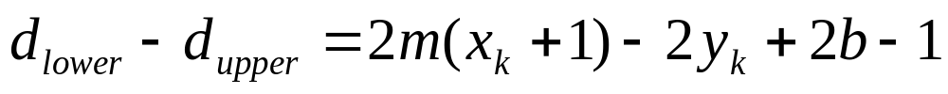
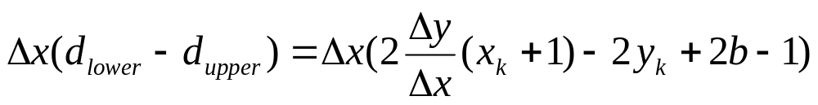
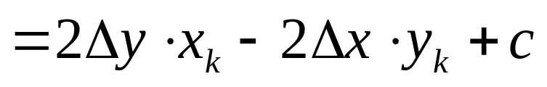
Deriving The Bresenham Line Algorithm (cont…)
This simple decision is based on the difference between the two pixel positions:
Let’s substitute m with ∆y/∆x where ∆x and
∆y are the differences between the end-points:

Slide 7
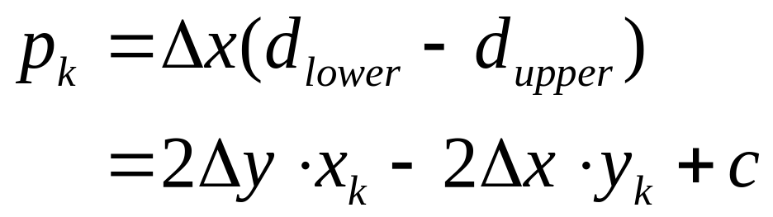
Deriving The Bresenham Line Algorithm (cont…)
So, a decision parameter p_{k} for the kth step along a line is given by:
The sign of the decision parameter p_{k} is the same as that of d_{lower} – d_{upper}
If p_{k} is negative, then we choose the lower pixel, otherwise we choose the upper pixel

Slide 8
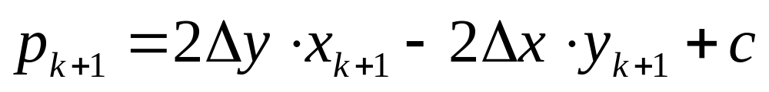
Deriving The Bresenham Line Algorithm (cont…)
Remember coordinate changes occur along the x axis in unit steps so we can do everything with integer calculations
At step k+1 the decision parameter is given as:
Subtracting p_{k} from this we get:

Slide 9
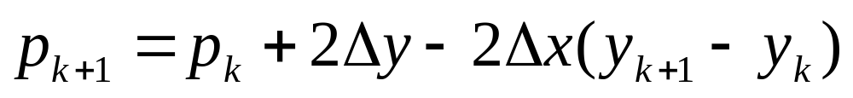
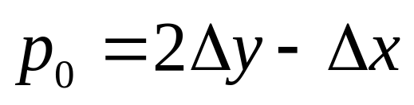
Deriving The Bresenham Line Algorithm (cont…)
But, x_{k+1} is the same as x_{k}+1 so:
where y_{k+1} - y_{k} is either 0 or 1 depending on the sign of p_{k}
The first decision parameter p0 is evaluated at (x0, y0) is given as:

Slide 10

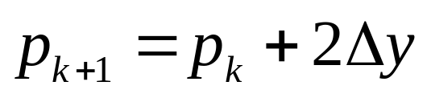
The Bresenham Line Algorithm
BRESENHAM’S LINE DRAWING ALGORITHM
(for |m| < 1.0)
Input the two line end-points, storing the left end-point in (x₀, y₀)
Plot the point (x₀, y₀)
Calculate the constants Δx, Δy, 2Δy, and (2Δy - 2Δx) and get the first value for the decision parameter as:
At each x_{k} along the line, starting at k = 0, perform the following test. If p_{k} < 0, the next point to plot is
(x_{k}+1, y_{k}) and:

Slide 11
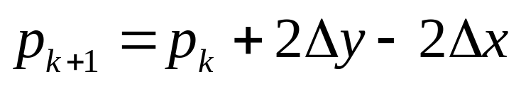
The Bresenham Line Algorithm (cont…)
Otherwise, the next point to plot is (x_{k}+1, y_{k}+1) and:
Repeat step 4 (Δx – 1) times

Slide 12
Bresenham Example
Let’s have a go at this
Let’s plot the line from (20, 10) to (30, 18)
First off calculate all of the constants:
  Δx: 10
  Δy: 8
  2Δy: 16
  2Δy - 2Δx: -4
Calculate the initial decision parameter p₀:
  p0 = 2Δy – Δx = 6

Slide 13
Bresenham Example (cont…)
k | p_{k} | (x_{k+1},y_{k+1})
0 1 2 3 4 5 6 7 8 9
18
17
16
15
14
13
12
11
10
20
21
22
23
24
25
26
27
28
29
30

Slide 14
Bresenham Exercise
Go through the steps of the Bresenham line drawing algorithm for a line going from (21,12) to (29,16)

Slide 15
Bresenham Exercise (cont…)
k | p_{k} | (x_{k+1},y_{k+1})
0 1 2 3 4 5 6 7 8
18
17
16
15
14
13
12
11
10
20
21
22
23
24
25
26
27
28
29
30

Slide 16
Bresenham Line Algorithm Summary
The Bresenham line algorithm has the following advantages:
  A fast incremental algorithm
  Uses only integer calculations
Comparing this to the DDA algorithm, DDA has the following problems:
  Accumulation of round-off errors can make the pixelated line drift away from what was intended
  The rounding operations and floating point arithmetic involved are time consuming

